Slide 1
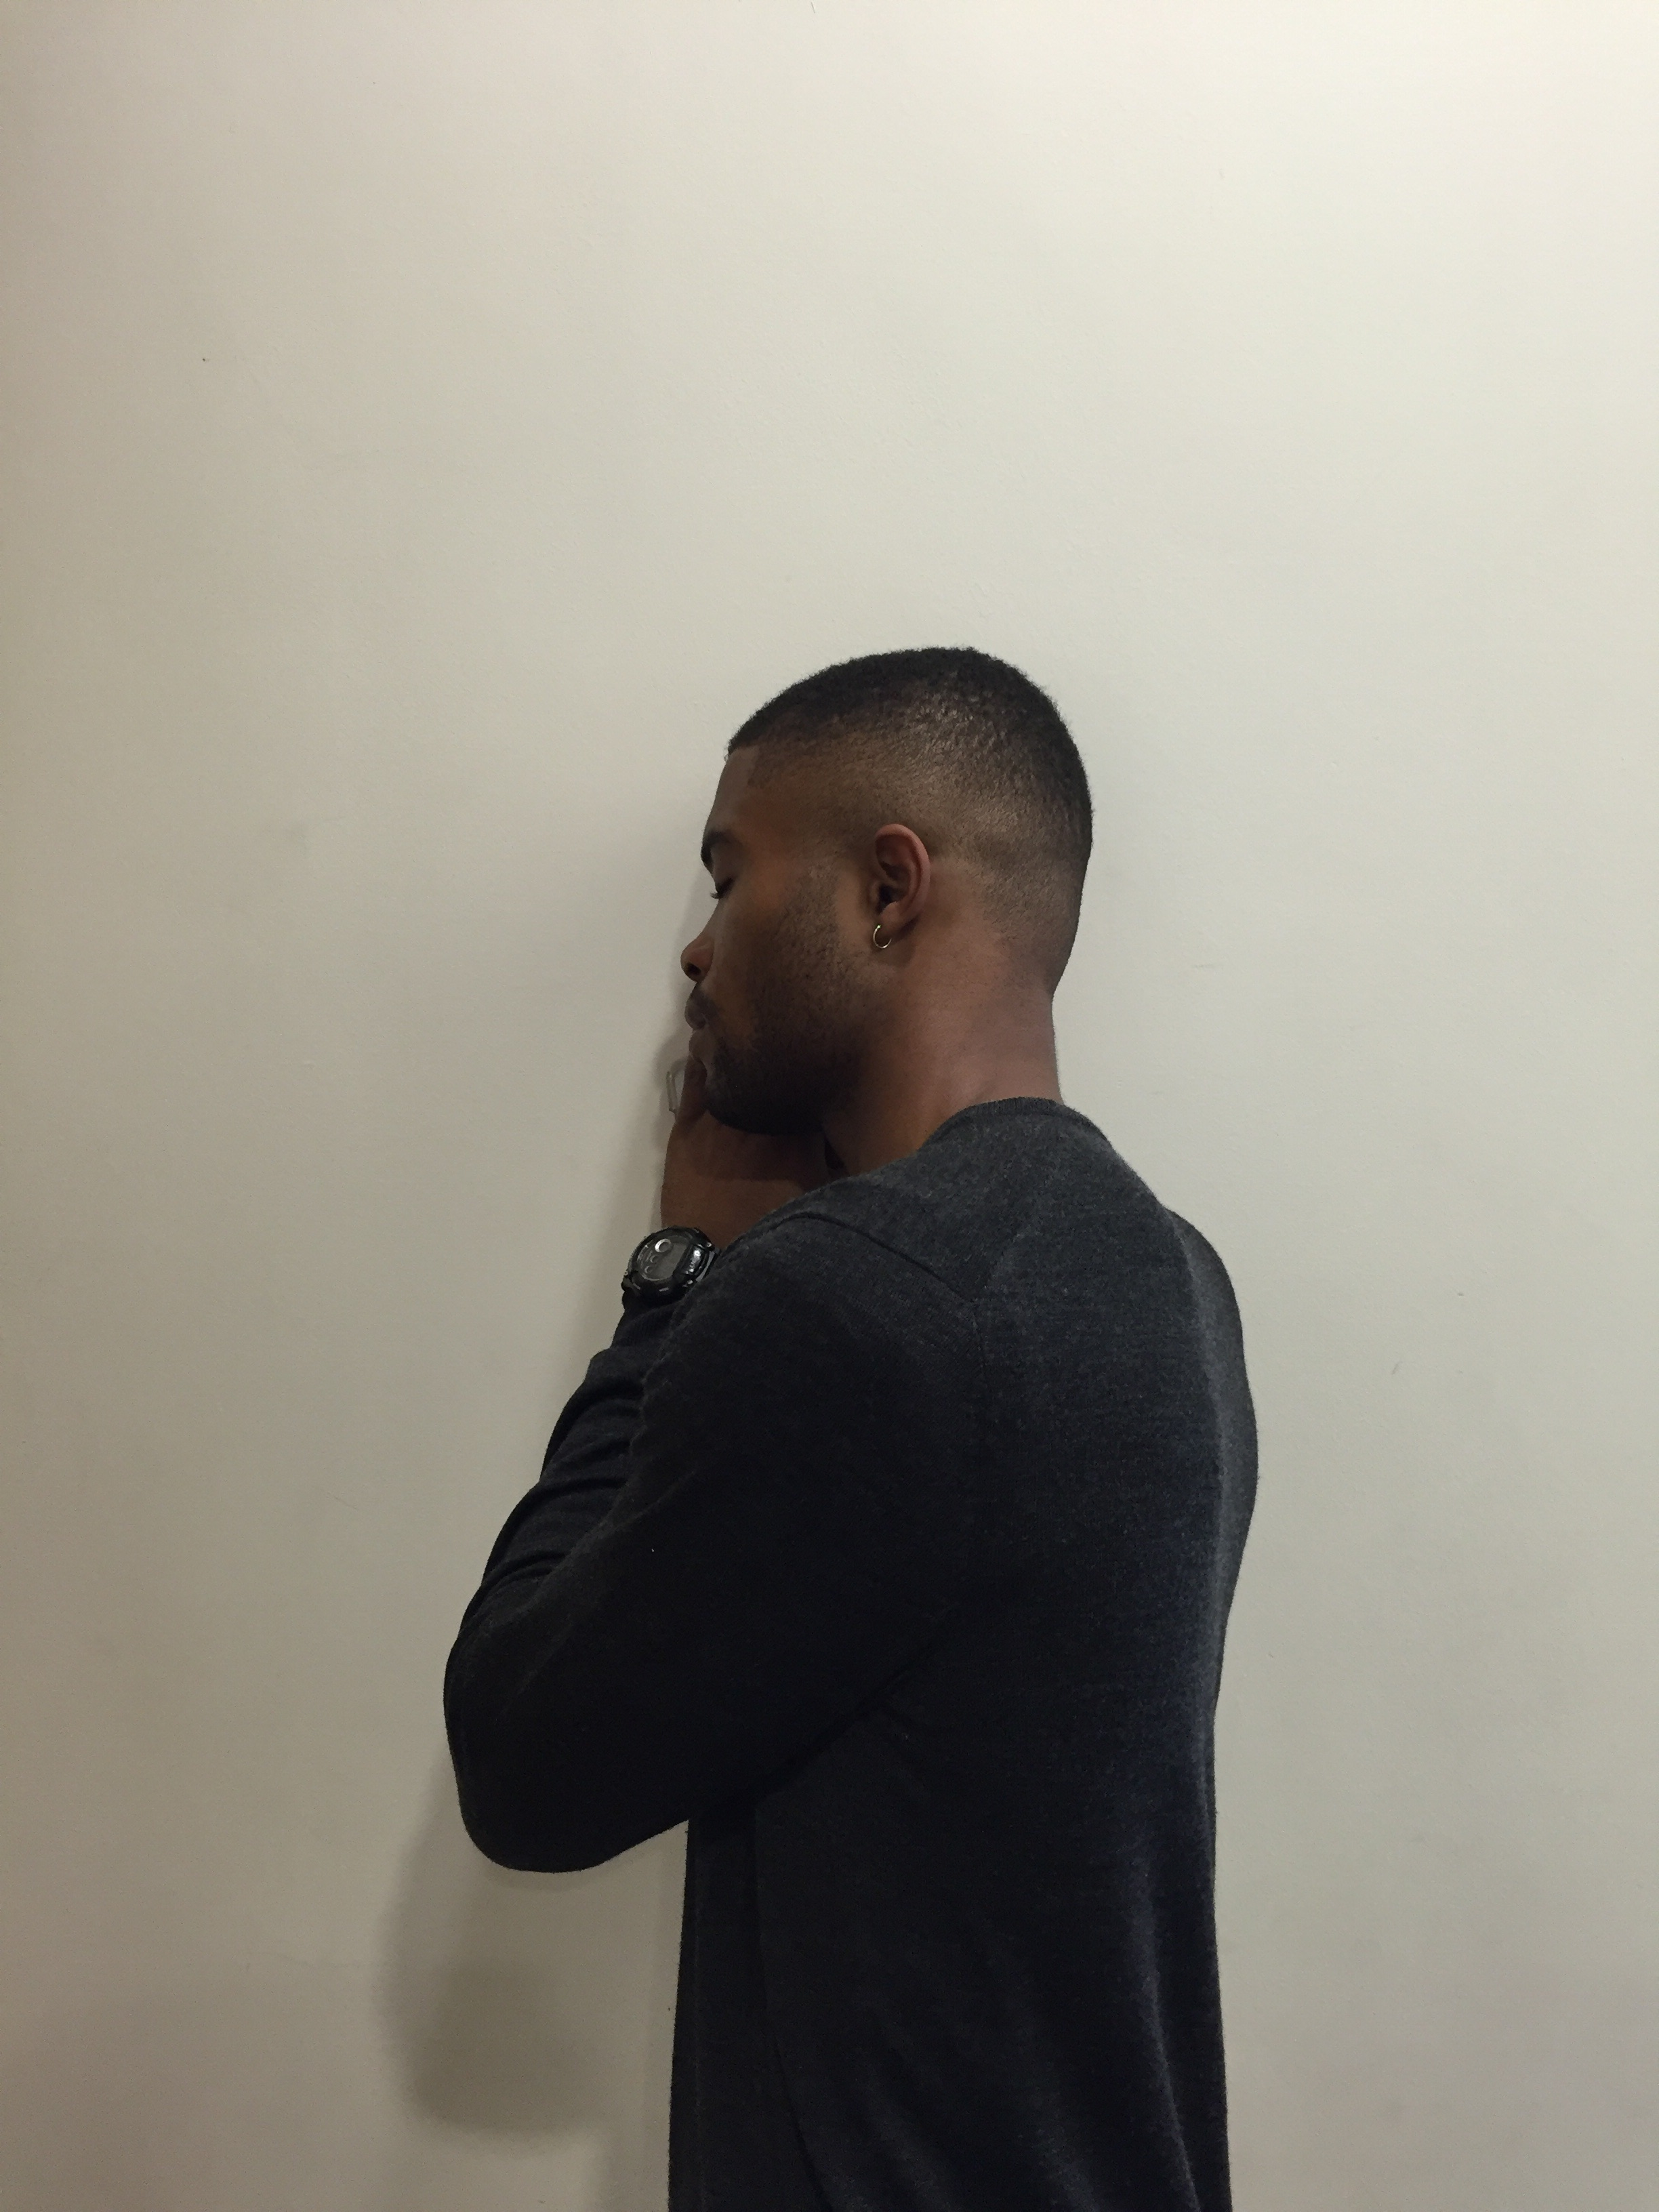
Billie
Notes:
This is Billie.

Slide 2

Billie
Notes:
He is 15 years old.

Slide 3

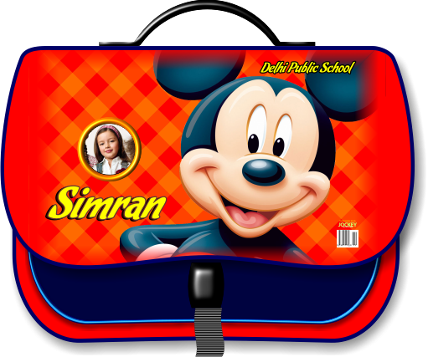
Billie
Notes:
Today is his first day at his new school.

Slide 4







Notes:
It’s 8.15am but he is still sleeping…

Slide 5

WAKE UP
BILLIE!!!
Notes:
Mom dashes into Billie’s room and screams: “WAKE UP BILLIE!!!”

Slide 6


Notes:
Billie jumps out of bed in shock!

Slide 7
LIFE IS
NOT ALWAYS
BEAUTIFUL
Notes:
Life is not always beautiful.

Slide 8



Notes:
Billie rushes to get dressed, but oh no, his uniform is too small!

Slide 9
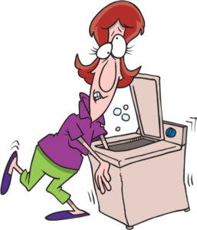
Notes:
Oh that’s right, Mommy must have gotten the washing machine setting wrong AGAIN…

Slide 10
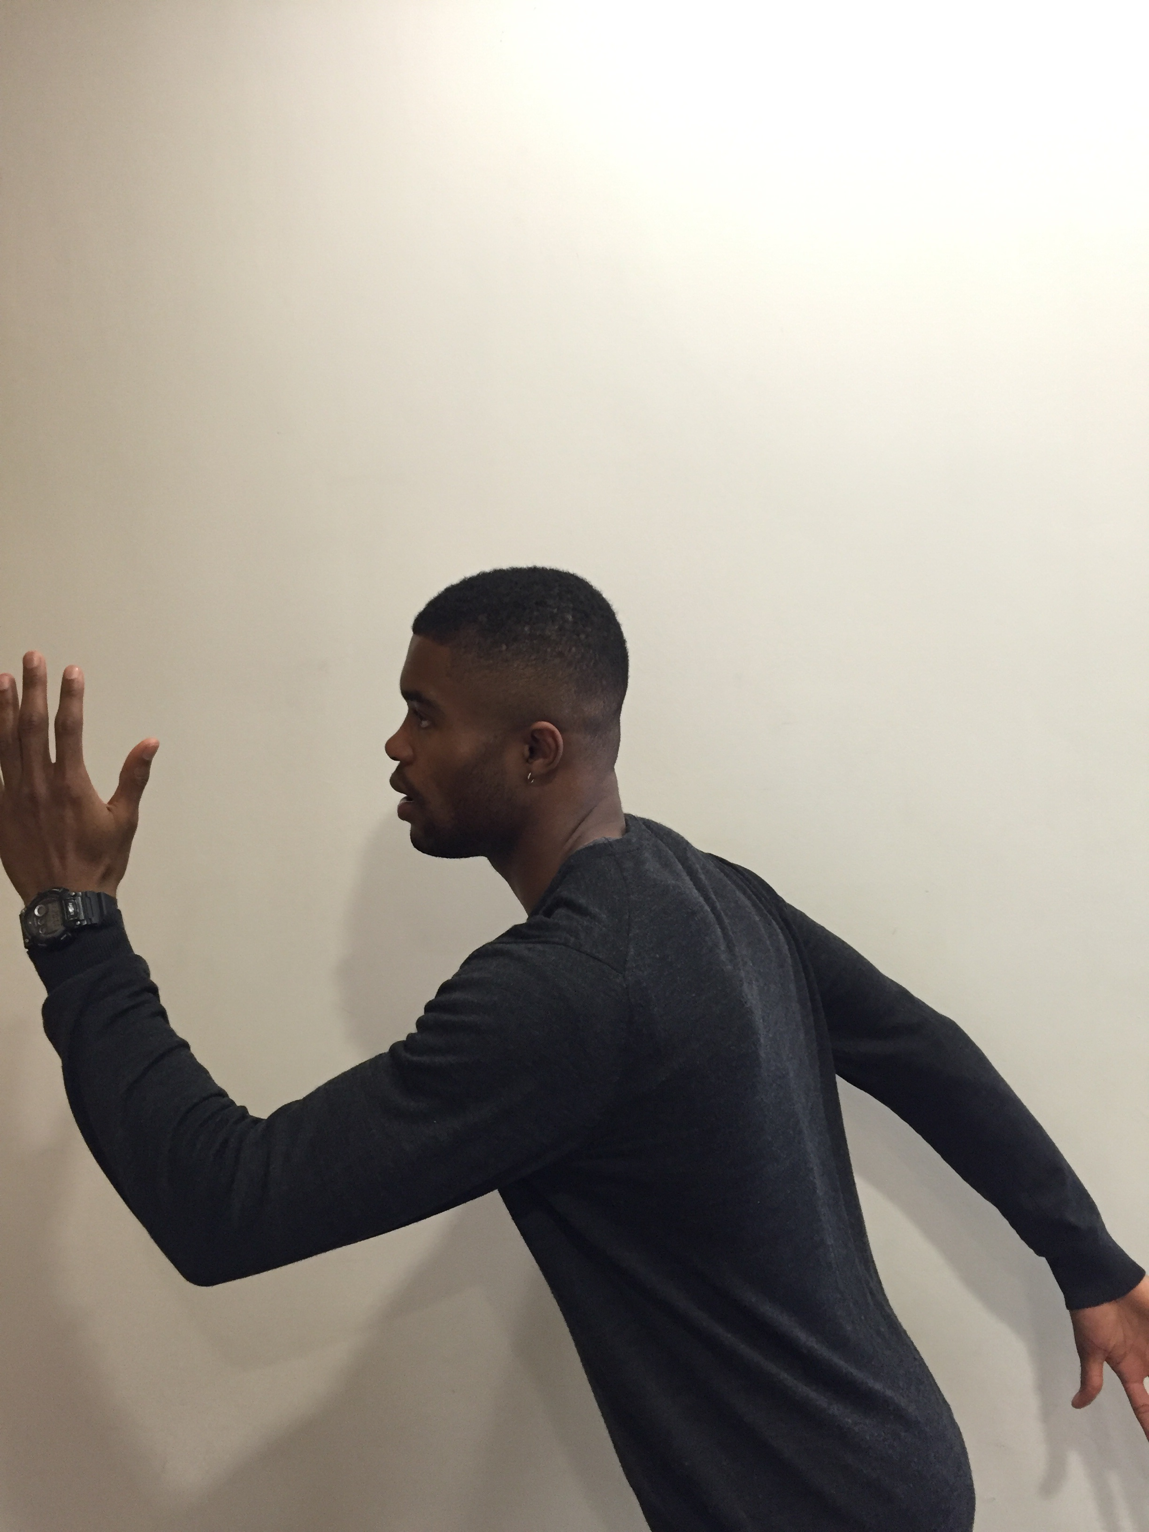

I’M GONNA BE
LATE!
Notes:
Already 15mins late, Billie rushes out of the house.

Slide 11
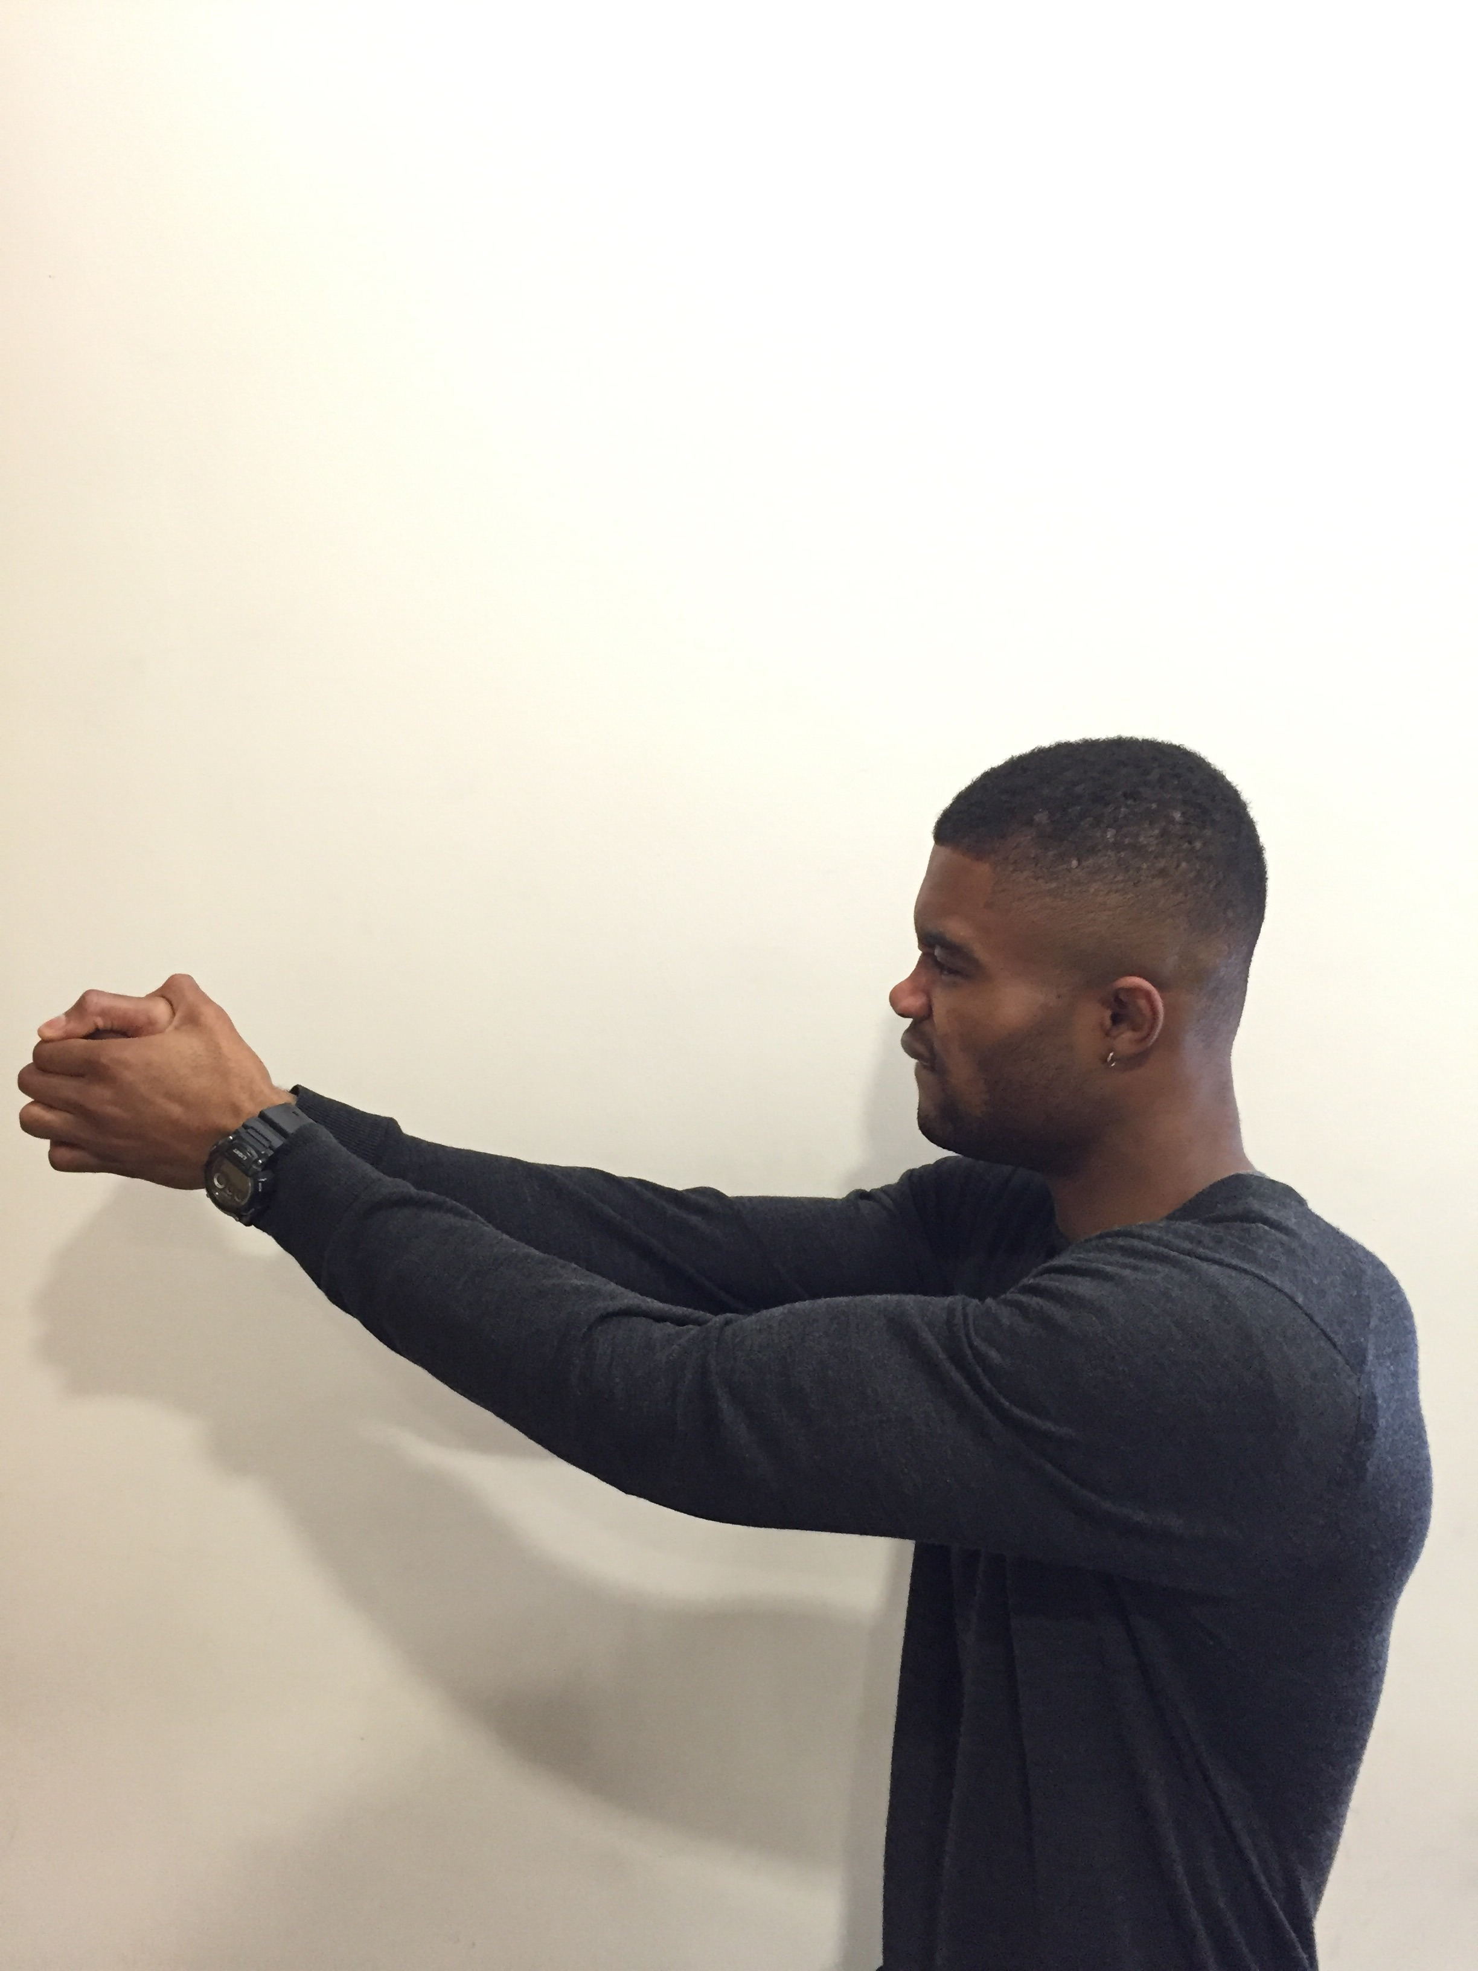

DOOR HANDLE
Notes:
He pulls the door in a hurry…

Slide 12
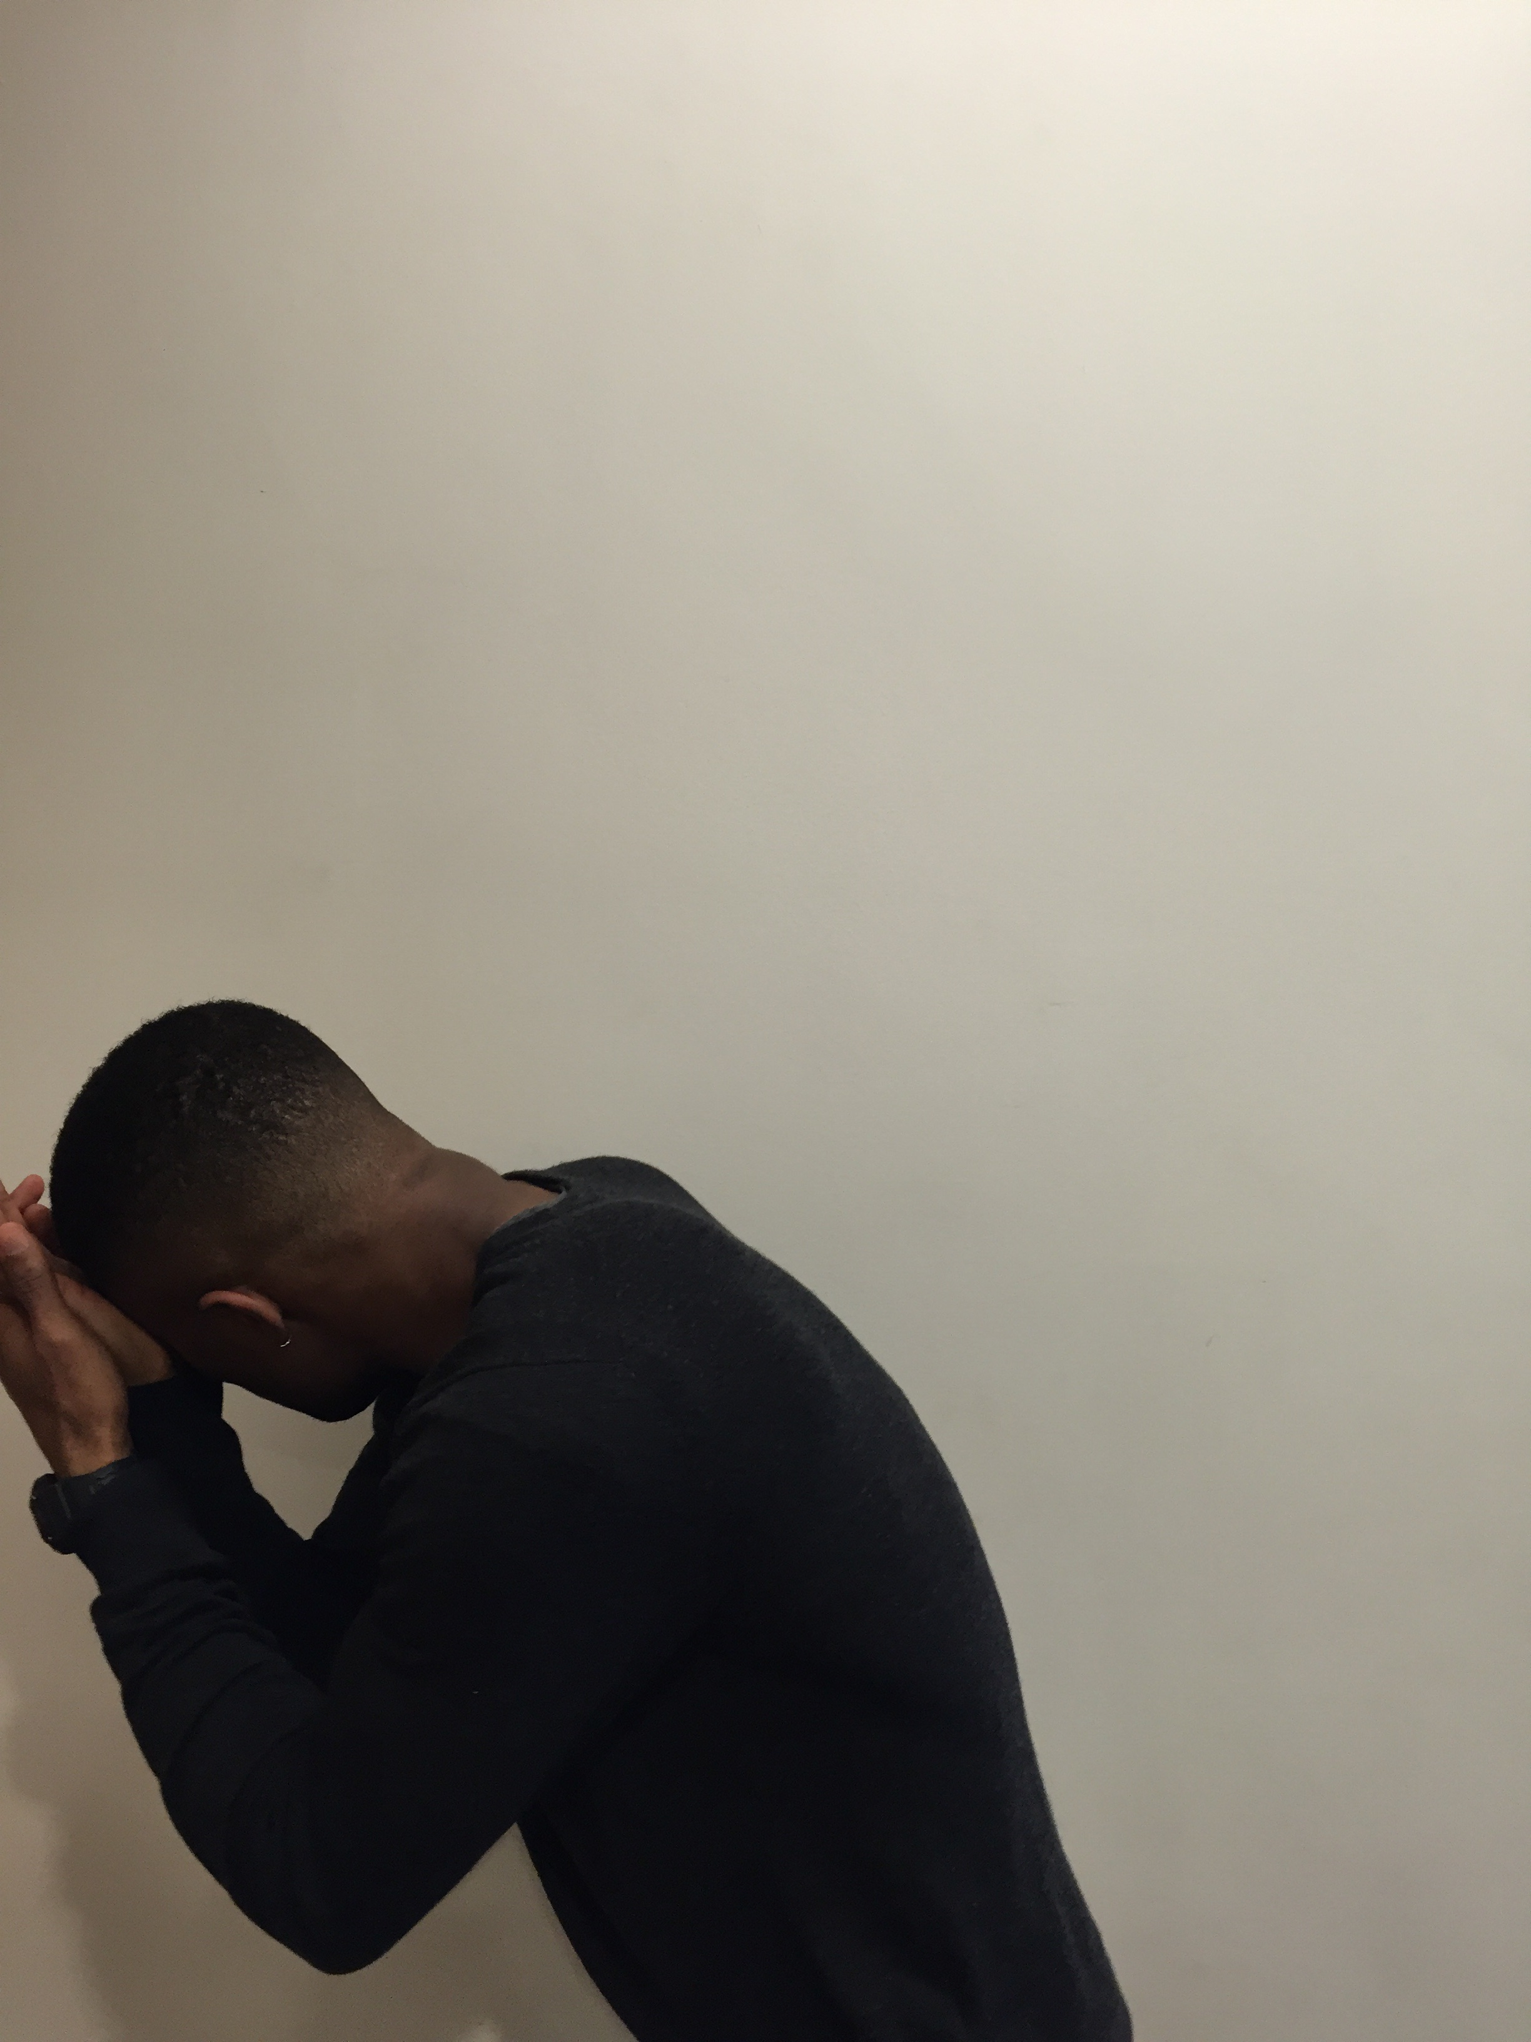

OUCHHH!!!
STUPID DOOR!
@@!@#$%^&()(*&^%$@
Notes:
But end up slamming right into the door… Stupid door. Finally he got out of the building…

Slide 13
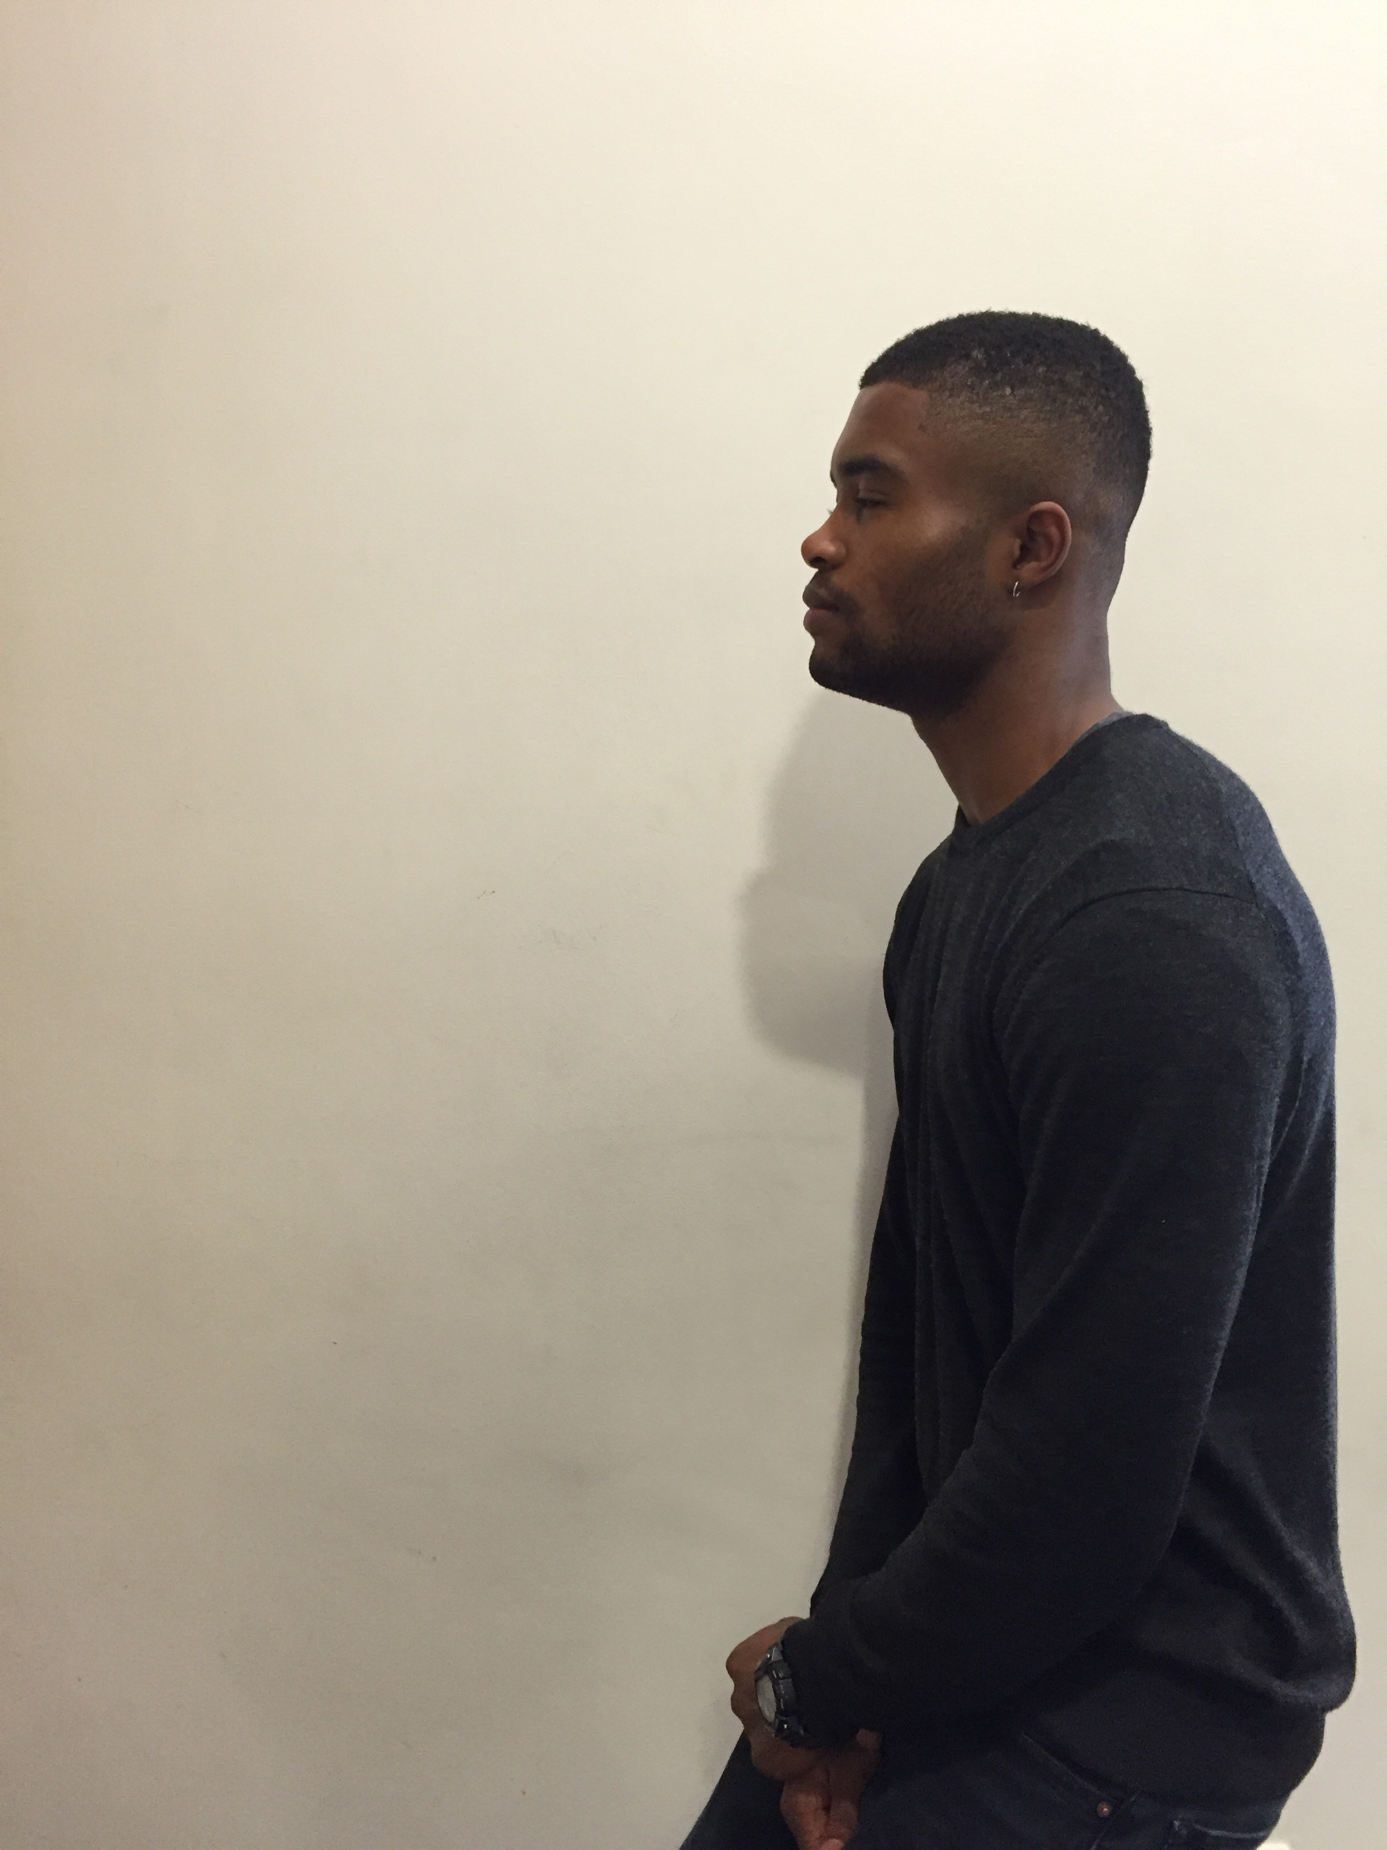
Notes:
Only to realise that he forgot his Oyster Card.

Slide 14
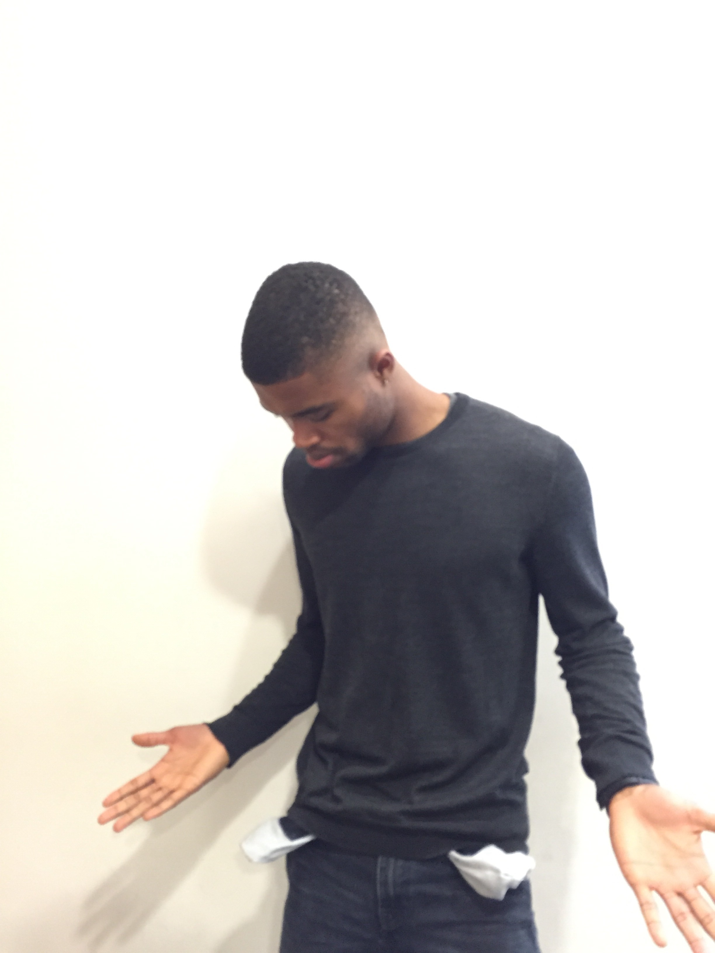

NOOOOO!!!
Notes:
Only to realise that he forgot his Oyster Card.

Slide 15

Notes:
So immediately…

Slide 16
DOOR HANDLE
Notes:
(Fast) He gets back through the same horrible door

Slide 17
I’M GONNA BE
LATE!
Notes:
(Fast) Rushes back into the house

Slide 18
Notes:
(Fast) In his really tiny uniform

Slide 19
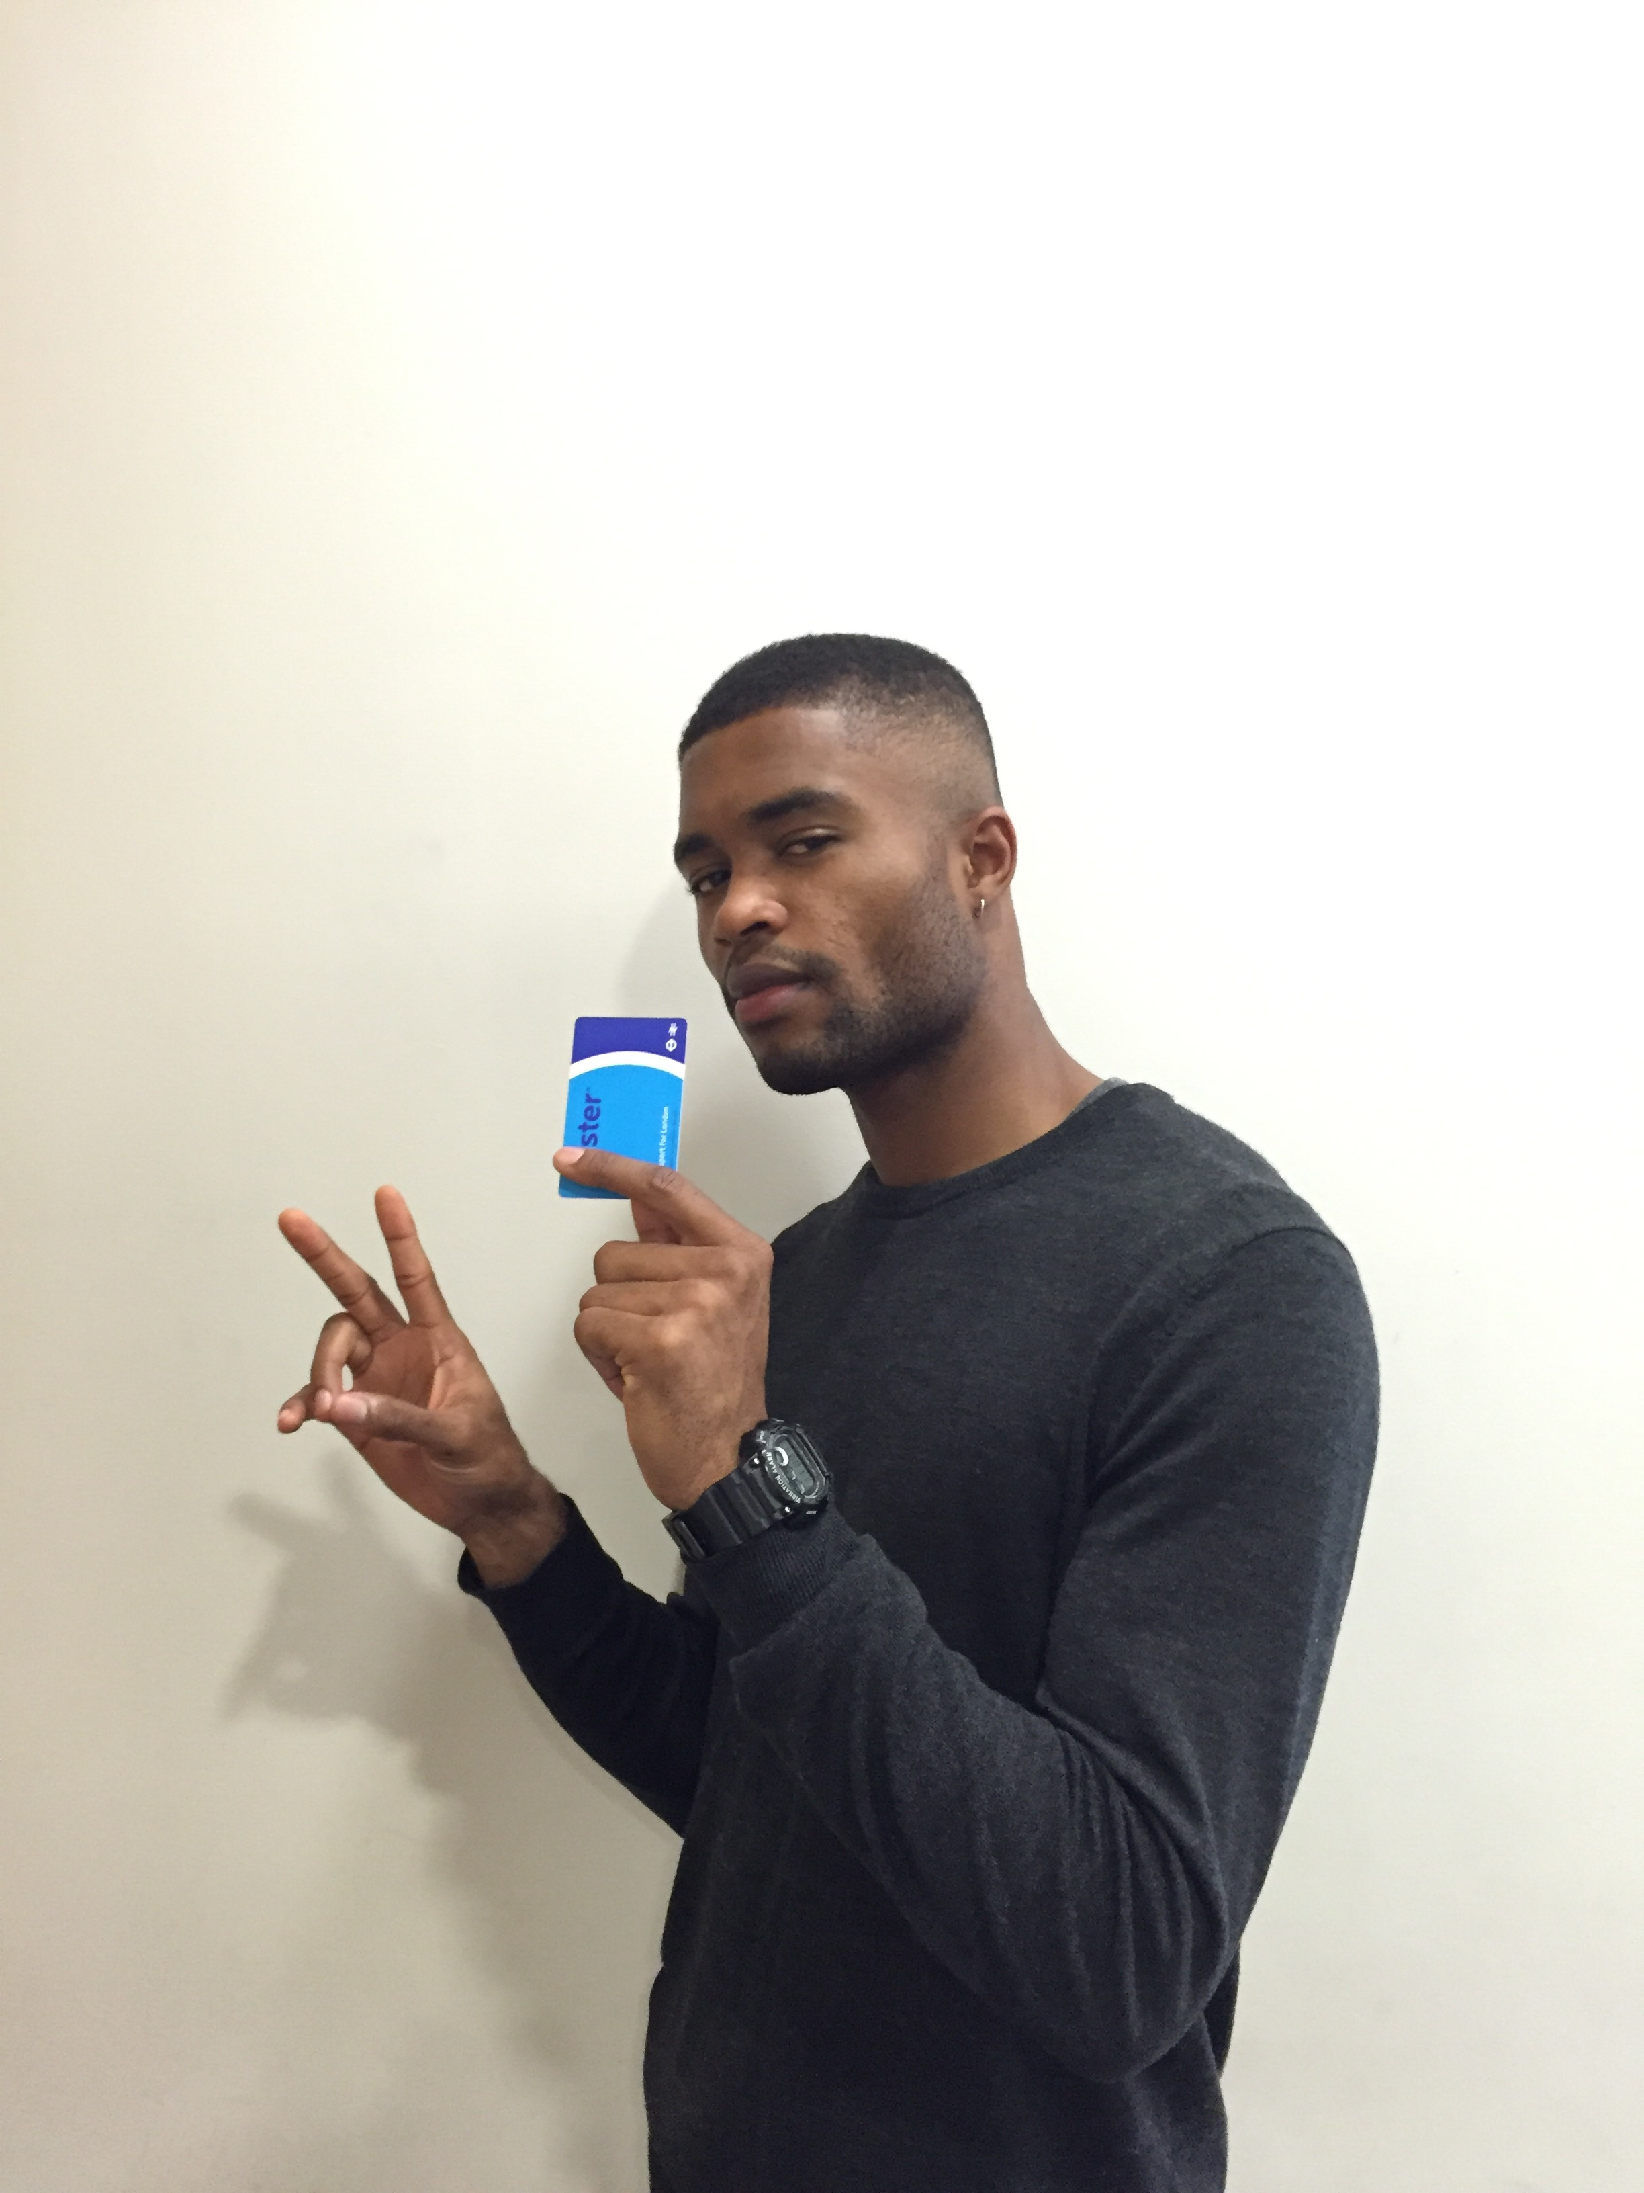
Notes:
(Fast) Picks up his Oyster Card!

Slide 20
I’M GONNA BE
LATE!
Notes:
(Fast) Rushes out of the house.

Slide 21
DOOR HANDLE
Notes:
(Fast) Pull the same horrible door in a hurry…

Slide 22
OUCHHH!!!
STUPID DOOR!
@@!@#$%^&()(*&^%$@
Notes:
(Fast) Slams right in the door, AGAIN!

Slide 23
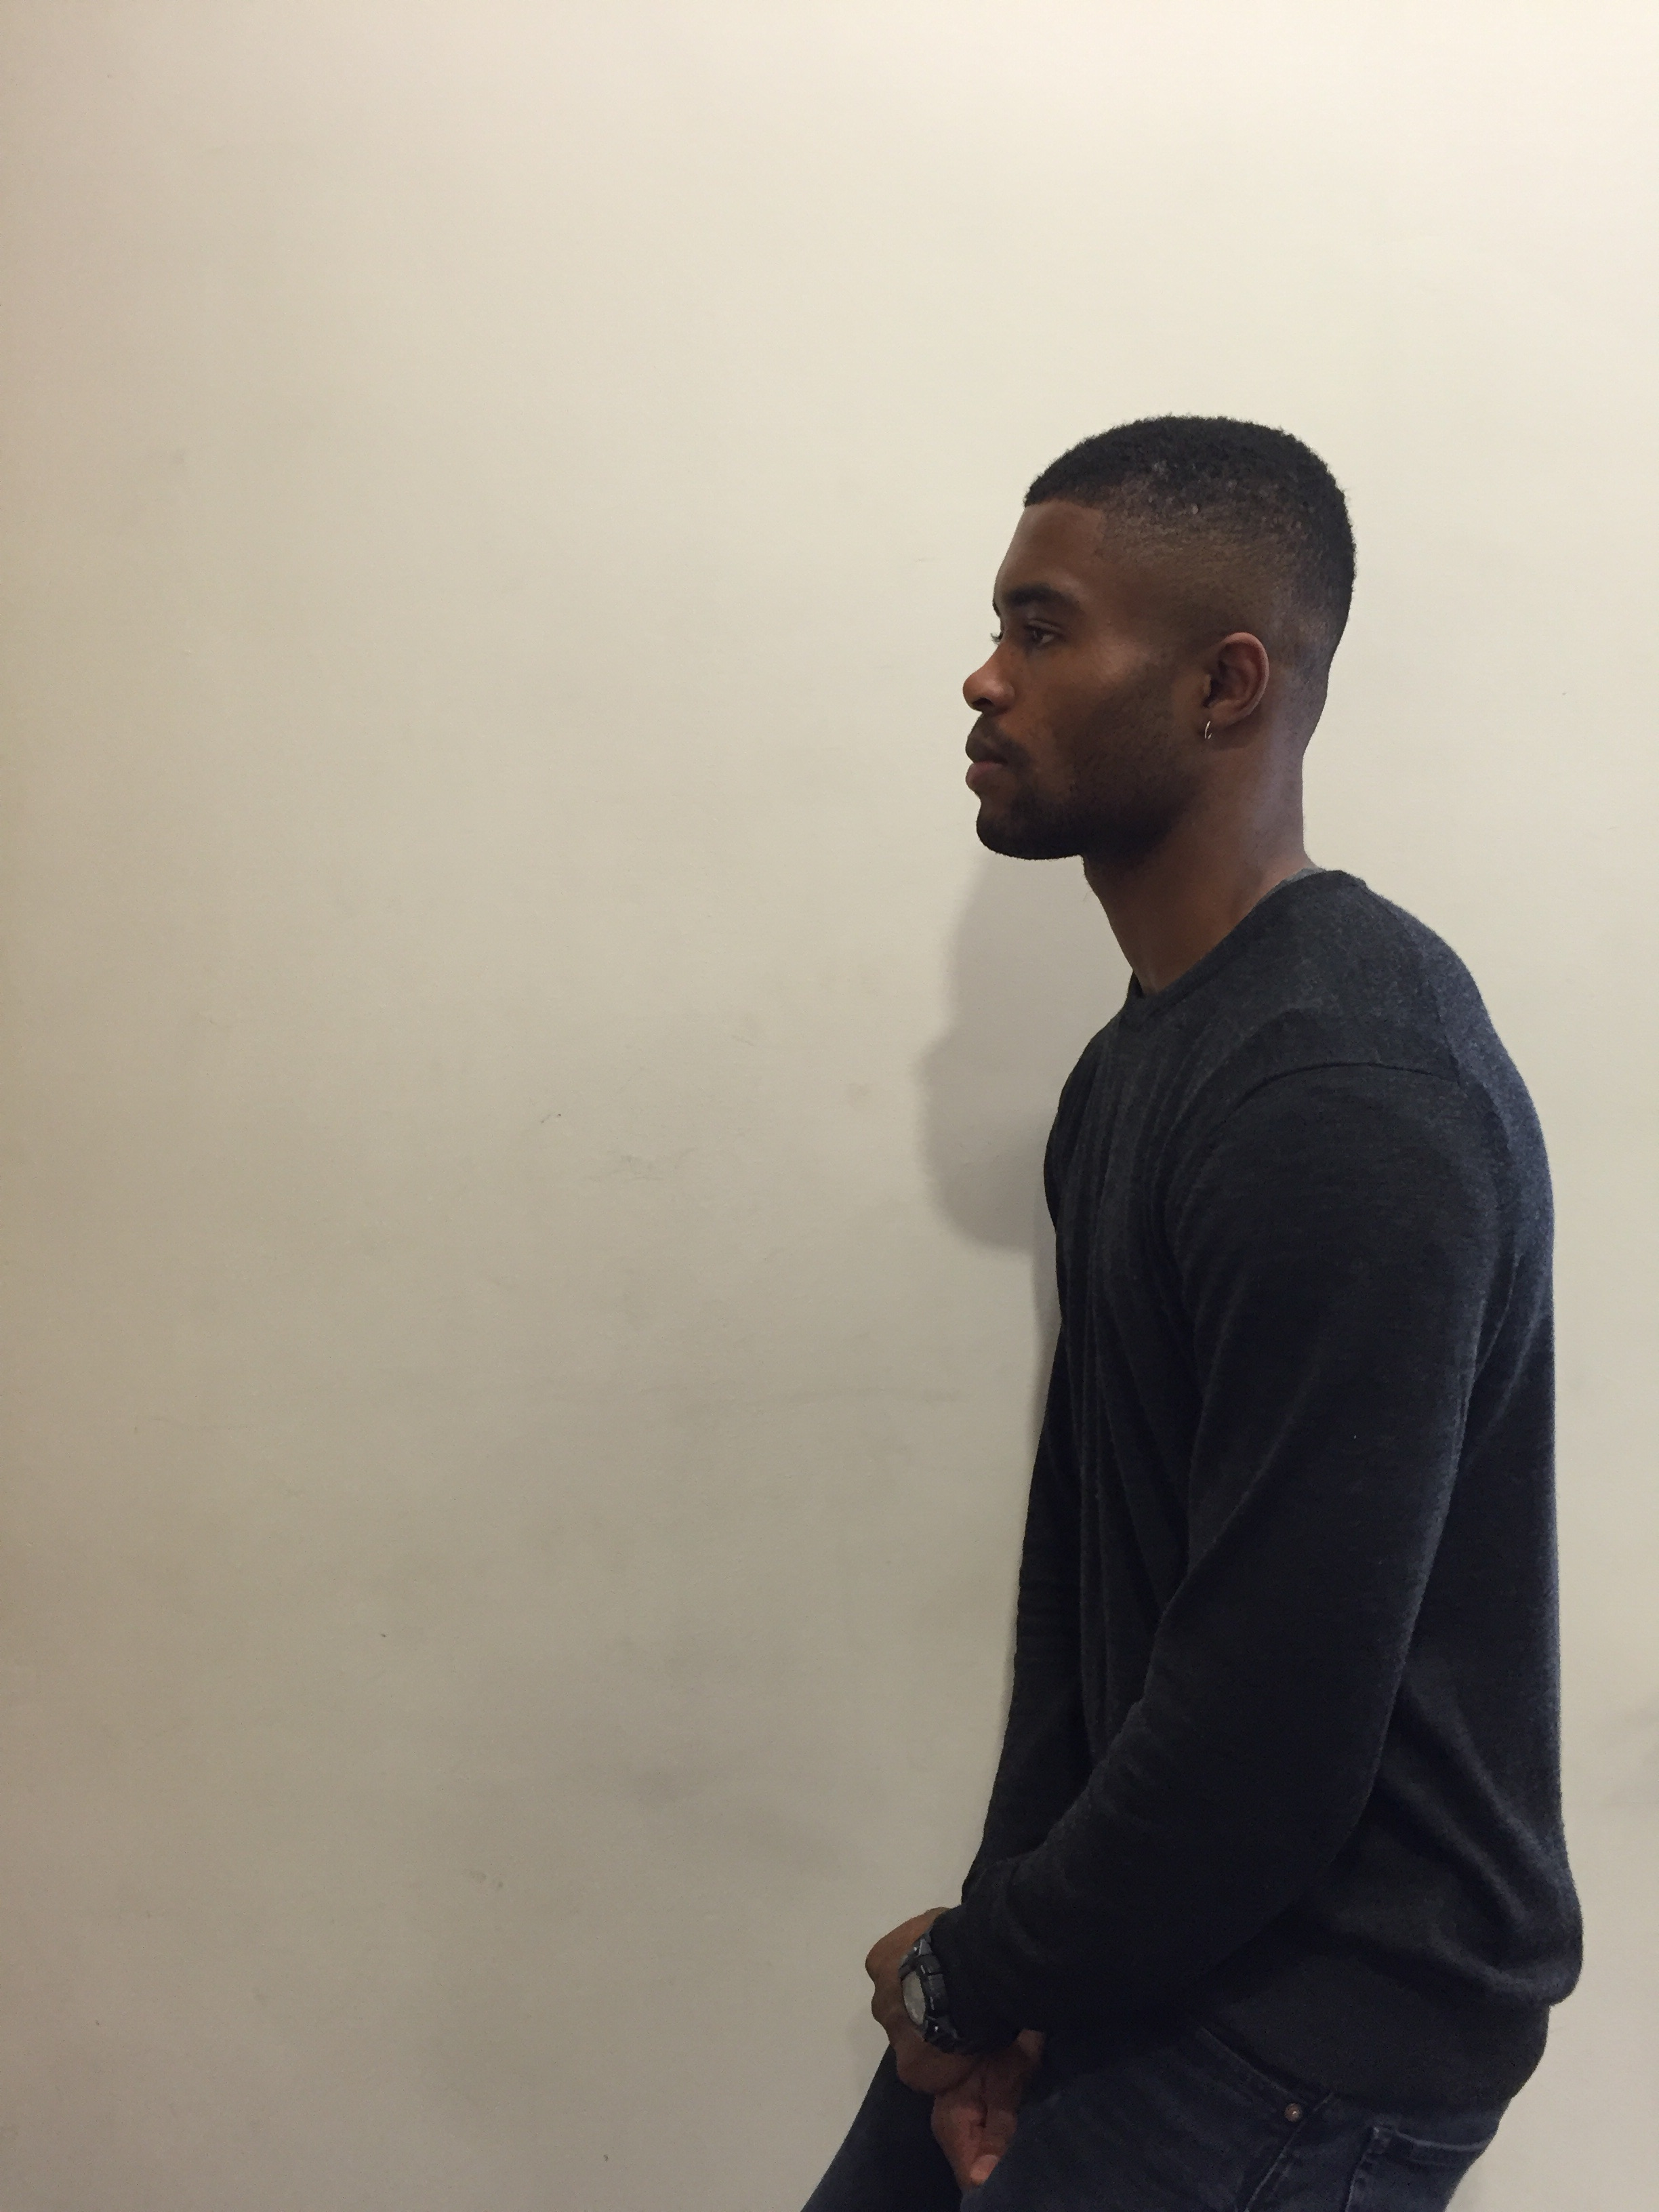
Notes:
(Fast) And finally, he is out of the building.

Slide 24
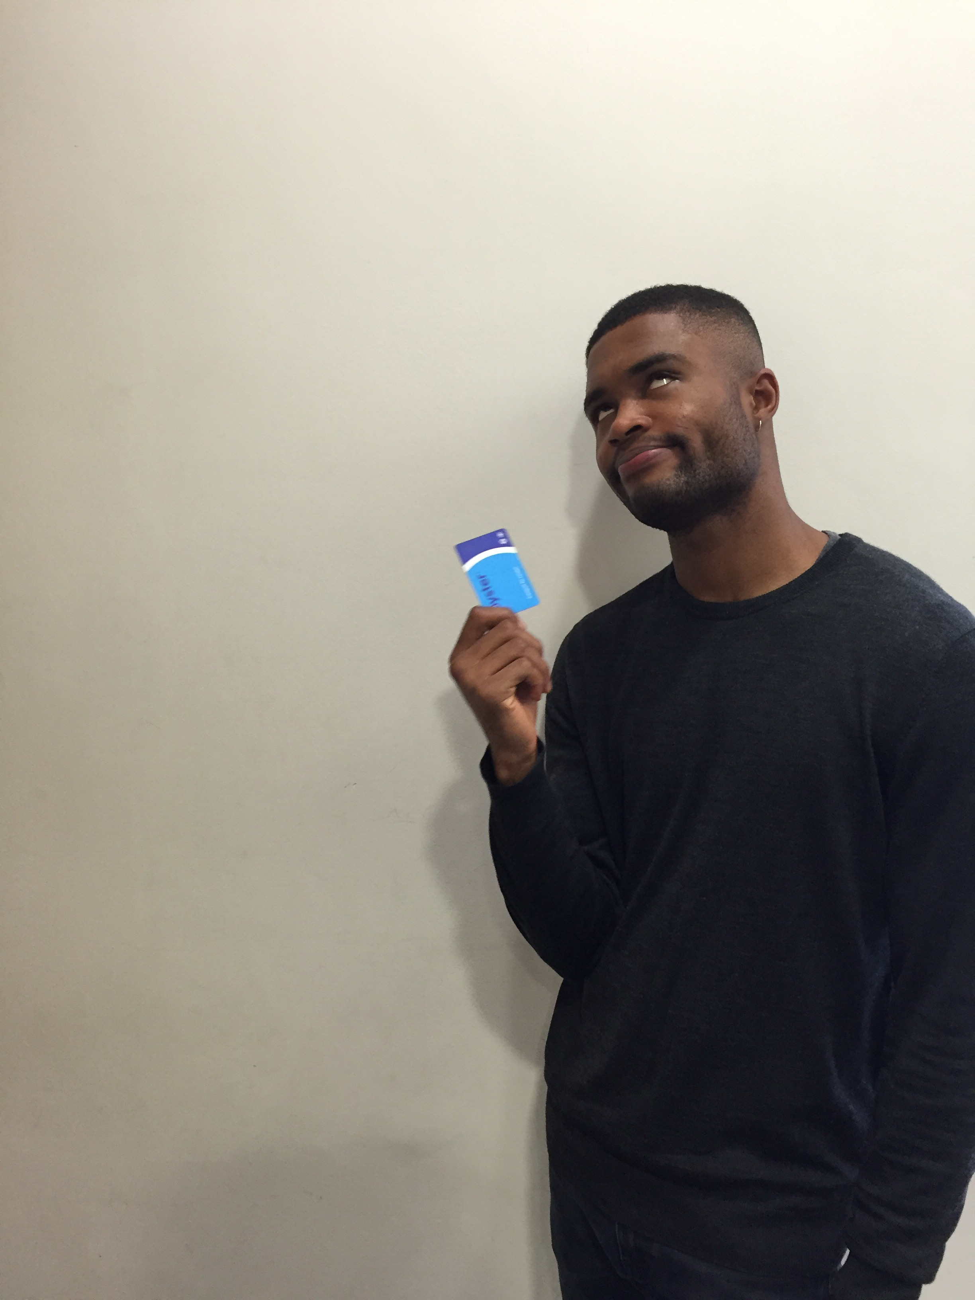

Notes:
(Fast) With his Oyster Card. (play “YAY!!!” sfx)

Slide 25
Notes:
(Fast) In his really tiny uniform

Slide 26
MOM:
REMEMBER,
BUS STOP C!
Notes:
Billie now has to get to the Bus Stop C.

Slide 27
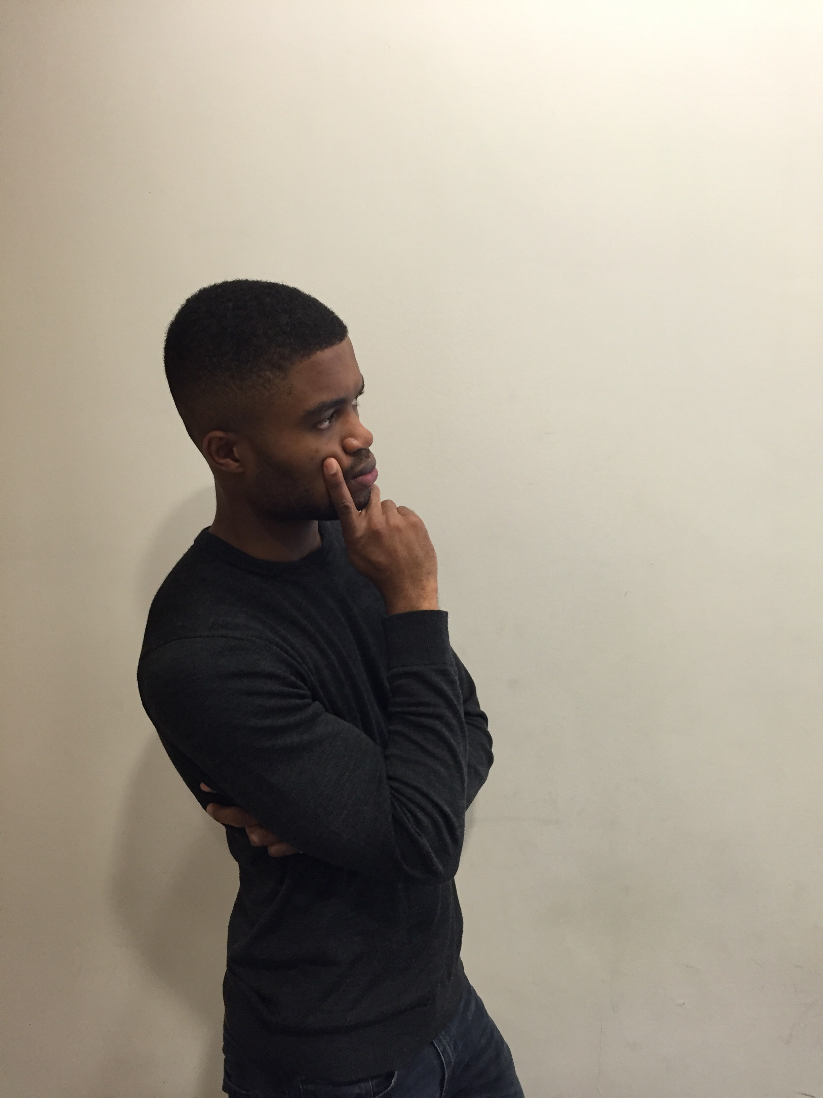

Notes:
But hey, where is Bus Stop C?

Slide 28
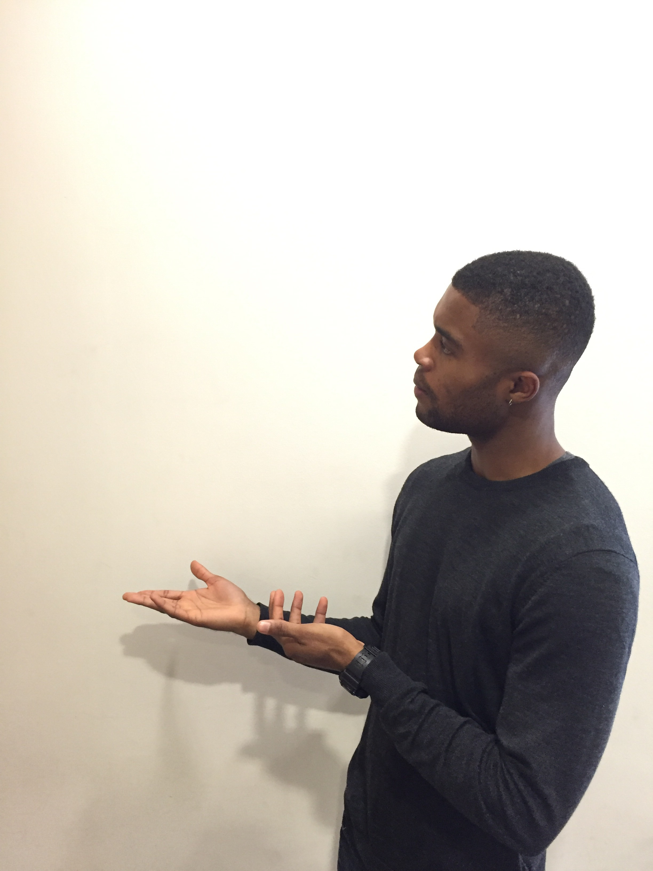

Notes:
(Fast) And an old man

Slide 29

Notes:
(Fast) Billie asks for directions from an old lady

Slide 30

Notes:
(Fast) A young lady

Slide 31

Notes:
(Fast) And also a young man

Slide 32
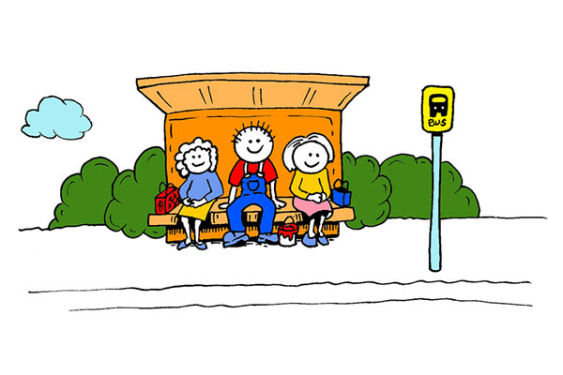
Notes:
Before he finally got to his bus stop.

Slide 33

10MINS
Notes:
(Fast) He waited for 10mins…

Slide 34
20MINS
Notes:
(Fast) 20mins…

Slide 35
30MINS
Notes:
But even after 30mins, there was no sign of his bus…

Slide 36
Notes:
Billie thinks to himself…

Slide 37
NEVER
GET TO SCHOOL
Notes:
(Fast) I’ll never get to school

Slide 38
NEVER
COMPLETE MY EDUCATION
Notes:
(Fast) I’ll never get complete my education

Slide 39
DOOMED
Notes:
(Fast) I’ll die alone #foreveralone

Slide 40
Notes:
(play sad music)

Slide 41
LIFE
CAN BE MADE
BEAUTIFUL
Notes:
But life can be made beautiful!

Slide 42

DANNIE
Notes:
This is Dannie

Slide 43
HCI NINJA
Notes:
She’s a HCI Ninja. But wait… what’s HCI?

Slide 44
Notes:
But hey, where is Bus Stop C?

Slide 45
HUMAN-COMPUTER INTERACTION
Notes:
HCI stands for Human-Computer Interaction

Slide 46

INTERVIEWS
Notes:
HCI Ninjas talk to people

Slide 47

INTERVIEWS
OBSERVATIONS
Notes:
Watch people

Slide 48

INTERVIEWS
OBSERVATIONS
USER-CENTRED DESIGN
Notes:
And solve everyday problems for everyone

Slide 49

Notes:
There aren’t many HCI ninjas around, but they are needed everywhere.

Slide 50
Billie
Notes:
This is Billie.

Slide 51
Billie
Notes:
He is 15 years old.

Slide 52
Billie
Notes:
Today is his first day at his new school.

Slide 53





Notes:
Billie wakes up fresh to the sweet sounds of birds chirping from his smart sleep app on his iPhone.

Slide 54

Notes:
He puts on his new school uniform, which fits him perfectly.

Slide 55


Notes:
Because the washing machine was so easy to use that mom will never get the settings wrong.

Slide 56
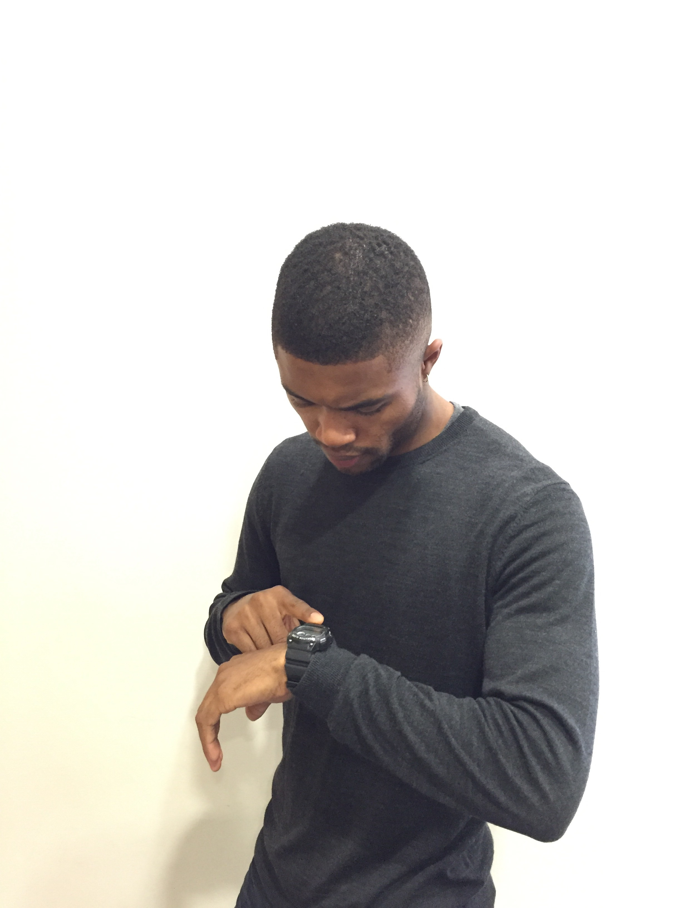


Notes:
Billie then gets a reminder on his smart watch to remember his Oyster Card.

Slide 57

WHEEEEE!
Notes:
Perfectly on time, Billie skips out of his house.

Slide 58
I LOVE THIS
DOOR!
Notes:
And had absolutely no problem opening the well-designed door.

Slide 59
Notes:
In no time, he was out of his house complete with his Oyster Card. (play “YAY!!!” sfx)

Slide 60
Notes:
Because the washing machine was so easy to use that mom will never get the settings wrong.

Slide 61
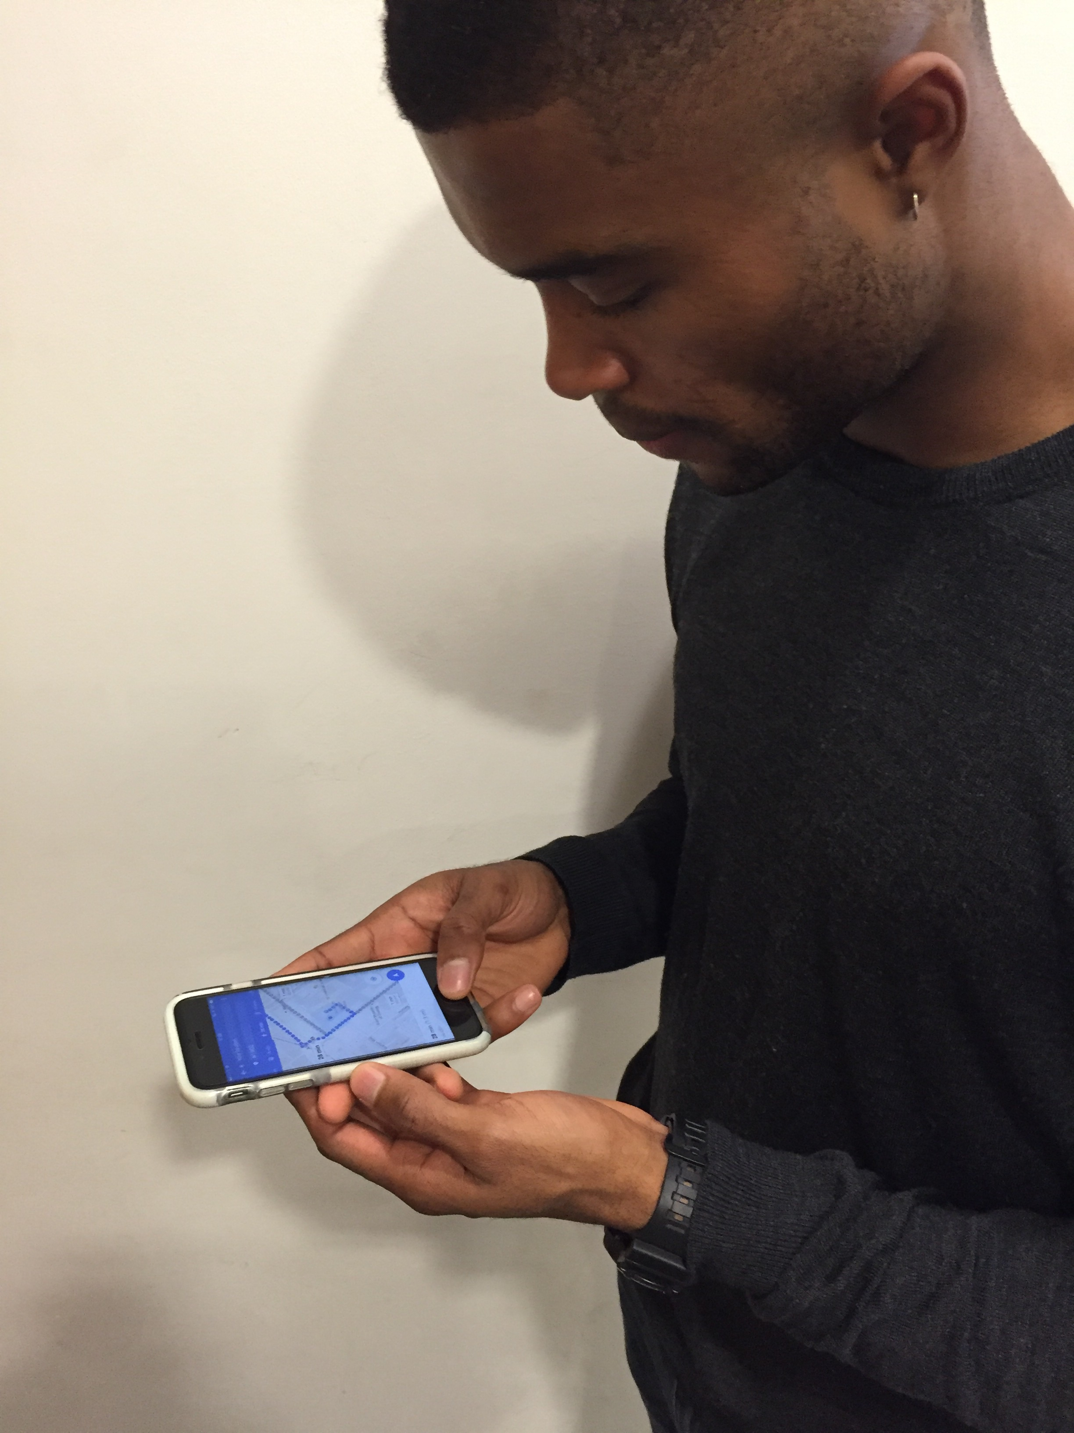
Notes:
Billie then checks his iPhone for directions to his new school.

Slide 62

Notes:
He boards the bus and gets to school on time.

Slide 63

Notes:
Billie thinks to himself…

Slide 64
LIFE IS BEAUTIFUL
#neveralone
Notes:
(Fast) Life is beautiful #neveralone

Slide 65








GUILLERMO
ANYA
GIOVANNA
JERALD
ELAINE
MATEJ
ALVIN
PETER

